Slide 1
Introduction to OAuth2.0
Some of the slides are taken from:
Understanding OAuth2.0, Amit Harsola, Wipro Technologies
https://www.slideshare.net/amitharsola/understanding-oauth-20

Slide 2
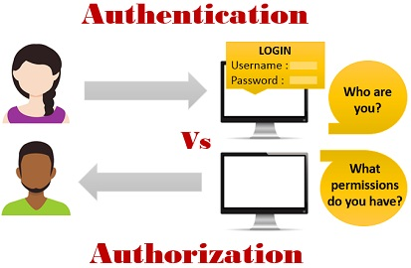
Authentication vs. Authorization
Authentication
Confirming your own identity
The process of verifying who you are
Authorization
Granting access to the system
Process of verifying what you have access to
4

Slide 3
Web Authentication
In a typical web authentication model, user owning the resource shares
credentials with other applications to provide them access to their protected data
The above approach presents significant challenges for the resource owners
1.
It requires sharing of passwords in clear text which third party applications stores
for any future use
2.
Any compromise of third party application results in compromise of user’s
password and its data
3.
Resource access revocation is only possible by user through password change
4.
Third party applications have full access to user’s data i.e. no data level or data
scope access
4

Slide 4
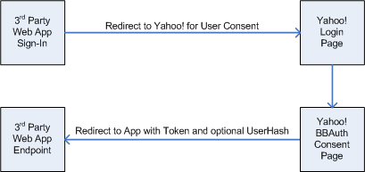
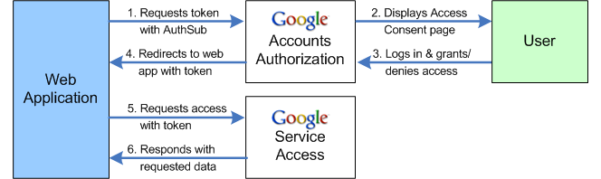
Social Web Integration
Several proprietary authorization protocols have emerged to address the
integration problem i.e. AuthSub (Google), OpenAuth (AOL), BBAuth (Yahoo),
Amazon Web Services API, etc
These proprietary protocols burdens the API consumers with implementations, all
serving the same purpose i.e. web integration for exchange of protected data.
Internet Engineering Task Force (IETF) have proposed an OAuth protocol which
integrates the commonalities and adopts the best practices of the proprietary
Web authorization protocols into a single open standard
BBAuth
AuthSub
6

Slide 5




What is OAuth?
OAuth stands for “Open Authorization”
An open standard protocol that provides simple and secure authorization for
different types of applications
A simple and safe method for consumers to interact with protected data
Allows providers to give access to users without any exchange of credentials
Designed for use only with HTTP protocol. It does not support any other protocol
7

Slide 6
Why OAuth?
OAuth is created by studying each of the proprietary protocols and extracting the
best practices
It is flexible, compatible and designed to work with mobile devices and desktop
applications
Provides a method for users to grant third-party access to their resources without
sharing their credentials.
Provides a way to grant limited access in terms of scope and duration
Has support from big players in the industry
8

Slide 7
History
OAuth Core specification 1.0 was published in Dec 2007
To fix a security issue, a revised specification was published in June 2009
OAuth 2.0 is a completely new protocol which is not backwards compatible
with previous versions. However, it retains the overall architecture and
approach established by the previous versions.
Various Services on the Web already support OAuth 2.0
❖
Facebook's API
❖ LinkedIn
❖ Github
❖ Google
❖ Salesforce
❖
Windows Live
9

Slide 8

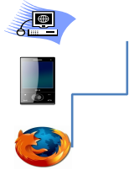





OAuth – Introduction
➢
User accesses consumer application which first gets user authenticated
through API Provider application for any exchange of information
➢
Once authenticated, consumer application and Provider exchange tokens
for authorization
➢
After successful authorization, consumer application gets access to users
resources on Provider application
Data Exchange
Access
Consumer
Application
API
Provider
User
12

Slide 9
















OAuth 2.0 – Overview
Authorization
Grant Request
Resource Owner
Client
An entity referring to a system
or a person (end-user) owning
the resources
An
applicatio
n that
makes
request
for
protected
resources
on behalf
of
Resource
Owner
with its
authorizati
on
Access Token
Request
Authorization Server
Server responsible for issuing
access tokens to the client
after successfully
authenticating the resource
owner and obtaining
authorization
Protected Resource
Access Request
Resource Server
An entity referring to a
system or a person (end-
user)
resources
owning
the
The authorization server may be the same server as the resource server or a
separate entity
14

Slide 10







Use Cases – Social Portals
Social Portals
It is the most common use case where organization intends to leverage the users of
Social Applications and APIs offered by them
Printing
Application
Flickr
Access Printing Application
Grant Access To Photos
Retrieve Photos
Deliver Printed Photos
Print Photos
60

Slide 11





Use Cases - Financial
Financial
Another use case of OAuth could be Personal Finance Management Applications.
Banking users could authorize bank to share all banking transactions with Money Finance
Application which would provide an holistic view of user’s financials
Personal
Finance App
Banking
Application
Access Application
Add Account
Authorize
Retrieve Transactions
61

Slide 12
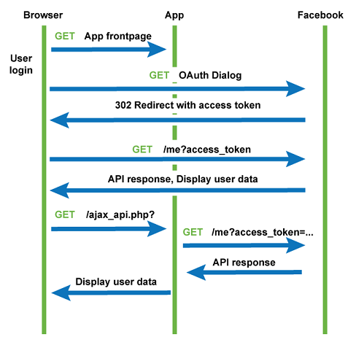
Use Cases – Facebook
Facebook OAuth
A secure, fast, and convenient way for users to log into your app, and for your app to ask for permissions to access data
Facebook Graph API
HTTP-based API that apps can use to programmatically query data, post new stories, manage ads, upload photos, and perform a wide variety of other tasks
62

Slide 13
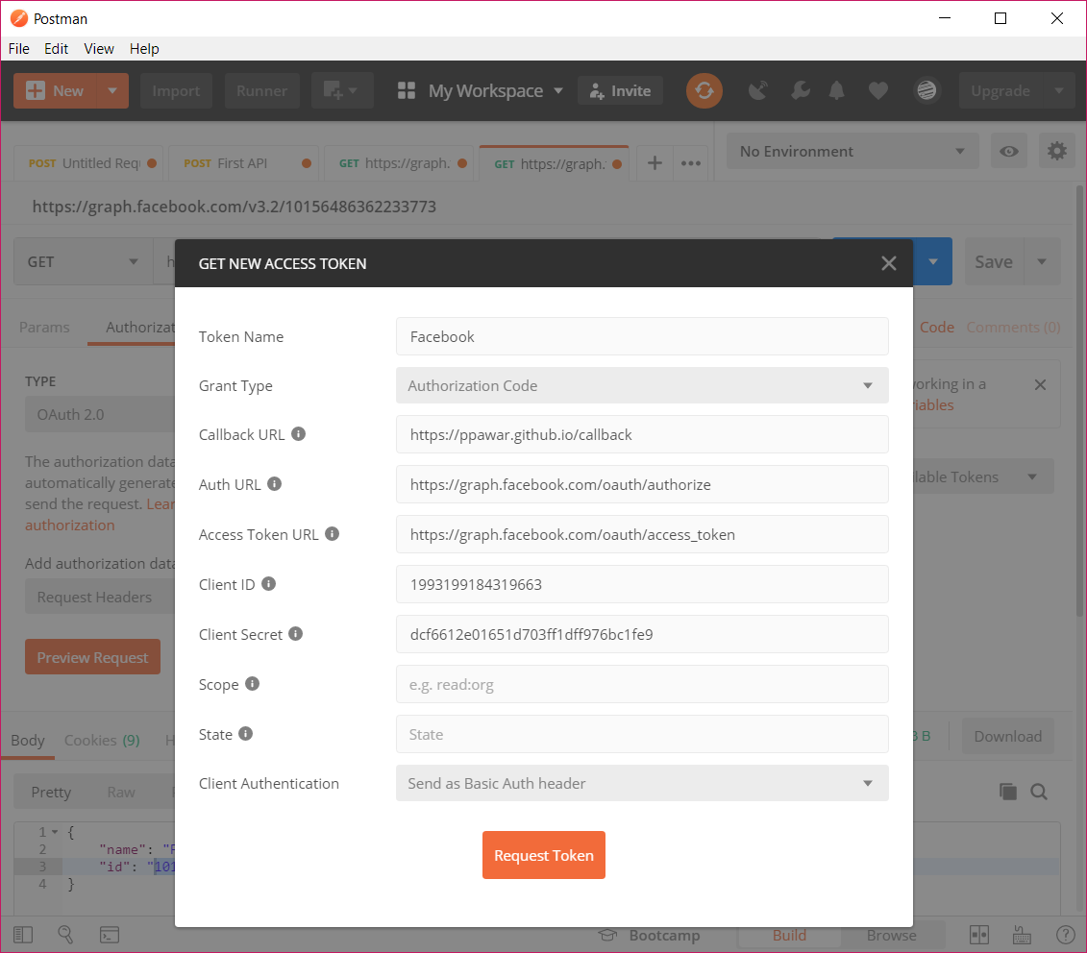
How to Use Facebook OAuth
Configuring Facebook Login
https://help.sharetribe.com/sharetribe-go-managing-your-go-marketplace/third-party-sign-up-services/how-to-configure-facebook-login
Postman Demo
62

